Slide 1


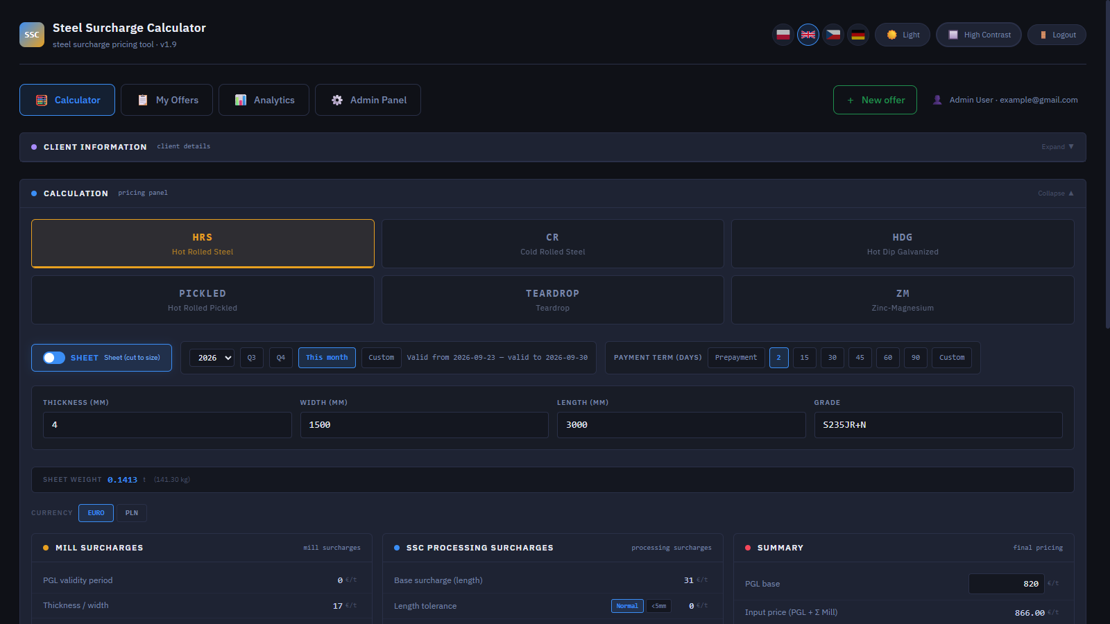
USER GUIDE · VERSION 1.9
AMSteel Quote
How to price, save and manage steel offers:
every tab, step by step
September 2026
Notes:
AMSteel Quote user guide. This deck walks through every tab of the app in the order you would use them, then explains how prices are calculated and what the app runs on.

Slide 2
CONTENTS
What this guide covers
Read it top to bottom the first time. Later, jump straight to the tab you need.
01
02
03
04
Getting started
Walkthrough
Pricing logic
Tech & hosting
Roles and what each one sees
Logging in
Calculator, step by step
My Offers and the offer lifecycle
Analytics
Senior Panel
Admin Panel (7 pages)
The five pricing steps
How delivery is priced
Currency, rounding, safety net
The technology, in plain words
Where the app can run
AMSteel Quote · User Guide
2
Notes:
Four parts. Part 2, the walkthrough, is the core of the guide: every tab with real screenshots and numbered callouts that match the steps next to them.

Slide 3

01 · GETTING STARTED
Three roles, three views of the app
What you see depends on your account type. Only an admin can create accounts.
1
Junior sales rep
2
Senior sales rep
3
Administrator
Builds and saves offers, and sends them once they are cleared.
Everything a junior does, plus reviews and approves flagged offers.
Manages prices, accounts and clients, and sees every offer.
TABS YOU SEE
TABS YOU SEE
TABS YOU SEE
Calculator
Calculator
Calculator
My Offers
My Offers
My Offers
Analytics
Analytics
Analytics
Senior Panel
Admin Panel
Analytics shows your own numbers only.
Analytics shows you and your team.
Analytics shows the whole company.
NOTE Admins approve offers from Admin Panel → Offers. The Senior Panel tab is only shown to senior sales reps.
AMSteel Quote · User Guide
3
Notes:
Junior: builds offers; offers that break the pricing rules need approval before they can be sent. Senior: can also approve or reject other people's flagged offers and manage a team of juniors. Admin: controls prices, accounts, clients and sees every offer in the company.

Slide 4
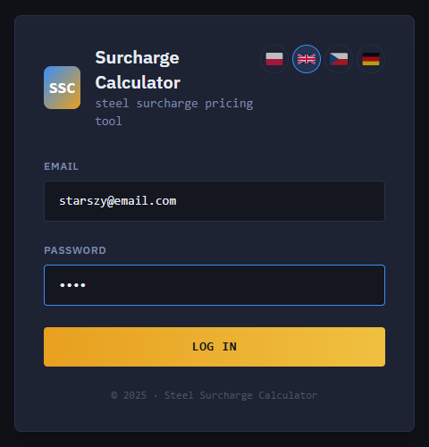
01 · GETTING STARTED
Logging in
Use the email and password your admin gave you. There is no sign-up page.
1
Email
Your work email. Accounts are created by an admin in Admin Panel → Salespeople.
4
2
Password
Ask your admin if you do not have one. A deactivated account cannot log in, even with the right password.
1
3
Log in
You land on the Calculator. The tabs you see depend on your role.
2
4
Language
Switch the interface between Polish, English, Czech and German at any time. The same flags are in the top bar after login.
3
TIP The top bar also has Light / Dark mode, High contrast and Logout. Your choices are remembered.
AMSteel Quote · User Guide
4
Notes:
Login screen. Only admins create accounts, so if you cannot log in, contact your admin. Language, theme and contrast can be changed at any time from the top bar.

Slide 5
02
Walkthrough
Every tab, in the order you use them:
Calculator → My Offers → Analytics → Senior Panel → Admin Panel

Slide 6
WALKTHROUGH · CALCULATOR
The Calculator screen at a glance
The main screen. Every offer starts here, and the price updates live as you type.
1
Client information
Pick an existing client or type a new one.
1
2
Steel type
HRS, CR, HDG, Pickled, Teardrop or ZM.
2
3
Form, validity & payment
Sheet or coil, offer validity, payment term.
3
4
4
Dimensions & grade
Sizes in mm and grade. Weight is calculated.
5
5
Live price panels
Surcharges and final €/t, updated live.
TIP + New offer (top right) starts a fresh quote. You are warned first if anything is unsaved.
AMSteel Quote · User Guide
6
Notes:
Overview of the Calculator. The next five slides go through it top to bottom: client, product, price panels, delivery, then the summary list and saving.

Slide 7
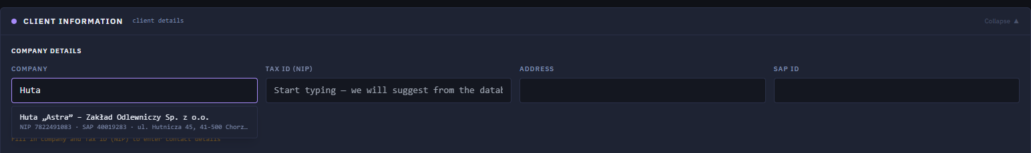
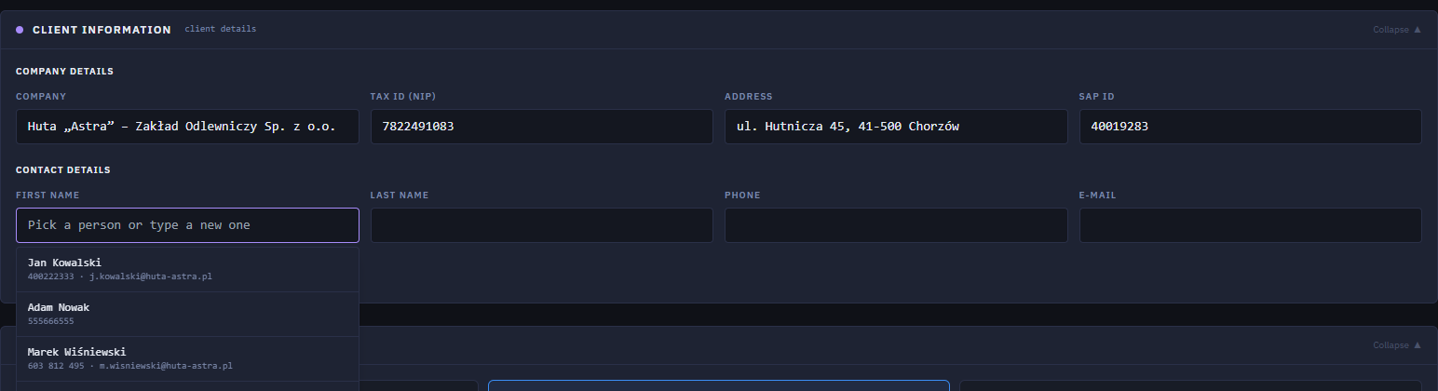
WALKTHROUGH · CALCULATOR · STEP 1
Pick the client and the contact person
Click "Client information" to expand it. The app suggests clients as you type.
1
Search the client
Type part of the company name or Tax ID (NIP) and pick it from the suggestions.
1
2
Details fill in
Tax ID, address and SAP ID are copied from the client record automatically.
2
3
Contact person
Click First name to see the people saved for this company.
3
4
4
Pick or add
Choose a saved contact, or type a new person and click "Save contact to company".
TIP Company name and Tax ID are required before an offer can be sent. A new client is added to the client list automatically when you save the offer.
AMSteel Quote · User Guide
7
Notes:
Client section. Autocomplete searches the client list by company name or Tax ID. Choosing a client fills the company details; the contact list shows only that company's people. A brand-new company typed here is saved to the client list together with the offer.

Slide 8
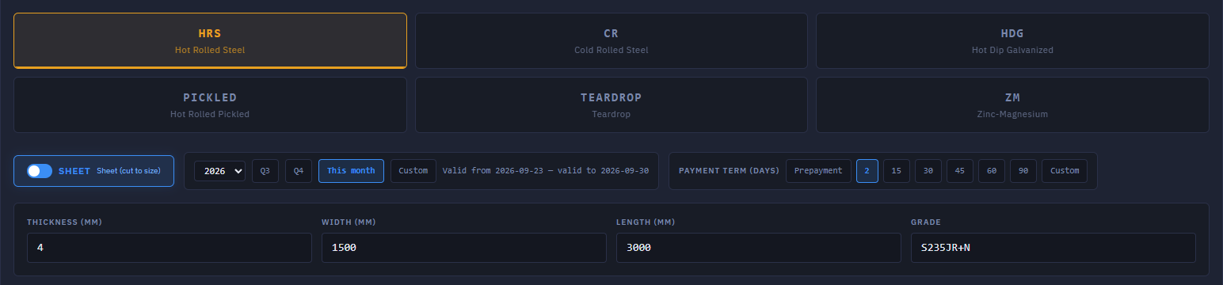
WALKTHROUGH · CALCULATOR · STEP 2
Describe the product
Steel type, form, dimensions, then how long the offer is valid and when the client pays.
1
Steel type
Decides which surcharges apply.
1
2
Sheet or coil
Sheet is cut to size (adds processing). Coil is sold as is.
2
3
3
Dimensions & grade
Sizes in mm; search the grade by name.
4
5
4
Offer validity
This month, a quarter or custom dates.
6
5
Payment term
Prepayment or 2–90 days; client term pre-filled.
TIP The heads-up (6) only informs you. You can still price the offer for that quarter: the base price for that quarter is used automatically.
6
PGL heads-up
That quarter has a different base price.
AMSteel Quote · User Guide
8
Notes:
Product setup. Choosing Q4 when Q4 has a different base PGL scheduled shows the heads-up, and the PGL base in the Summary switches to the Q4 value. Payment term defaults to the client's own term when the client record has one, otherwise to the default set in Settings.

Slide 9
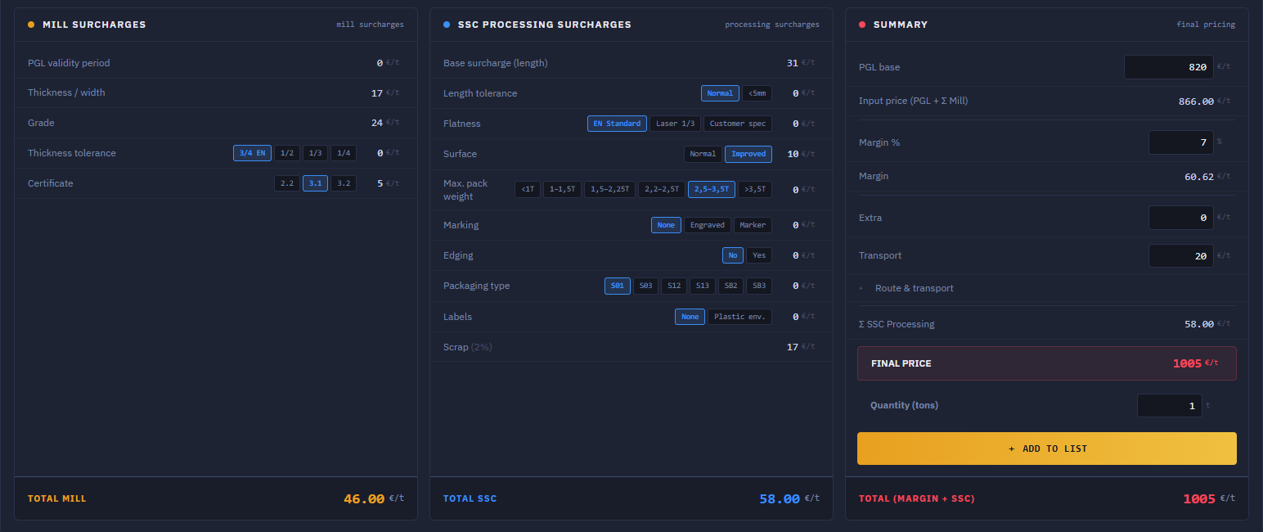
WALKTHROUGH · CALCULATOR · STEP 3
Read and adjust the price
Three panels build the price per tonne. Most values come from Settings; you adjust a few.
1
Mill surcharges
Size, grade, tolerance, certificate, extras.
3
4
2
Processing (SSC)
Cutting extras plus scrap. Sheets only.
5
3
PGL base
Base €/t from Settings; can be overridden.
6
4
Margin %
A % of the input price.
1
2
7
5
Extra & transport
Manual extra €/t; transport from the route.
EXAMPLE Example on screen: 820 PGL + 46 mill = 866 input price · + 58 processing · + 60.62 margin (7% of 866) · + 20 transport = 1,004.62 → rounded up to 1,005 €/t.
6
Final price
All added up, rounded up, in €/t.
7
Quantity & add
Enter tonnes, click Add to list.
AMSteel Quote · User Guide
9
Notes:
Price panels. Option buttons in the mill and processing panels (tolerance, certificate, flatness, surface, packaging, marking...) each add their own surcharge, shown on the right of the row. The Summary panel adds PGL, mill, processing, margin, extra and transport. If margin is below the minimum set in Settings, the offer will need approval.

Slide 10
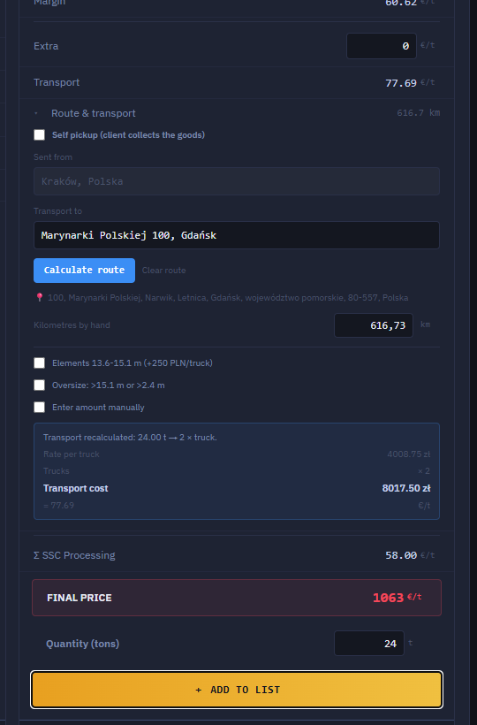
WALKTHROUGH · CALCULATOR · STEP 4
Price the delivery
Enter the address once. The app finds the distance and works out trucks and cost for the whole order.
1
Open "Route & transport"
Tick Self pickup if the client collects the goods: no transport is charged.
6
1
2
Where to
Type the delivery address (or reuse the one from the client record) and click Calculate route. The distance is looked up online.
2
3
Kilometres by hand
If the lookup ever fails, type the distance yourself. Pricing never gets stuck.
3
4
4
Special loads
Flag long elements (13.6–15.1 m, surcharge per truck) or oversize loads, or enter the transport amount manually.
5
5
Trucks & cost
Total tonnes ÷ truck capacity, always rounded up: 24 t needs 2 trucks. Each truck is priced from the rate card.
6
Transport €/t
The total transport cost spread over the tonnes and added to the final price.
AMSteel Quote · User Guide
10
Notes:
Delivery is priced once for the whole order, not per line. The distance comes from an online mapping service. Truck count always rounds up: even half a tonne over a full truck pays for another truck. Short distances use flat prices; longer ones a price per km (see Settings, transport rate card).

Slide 11
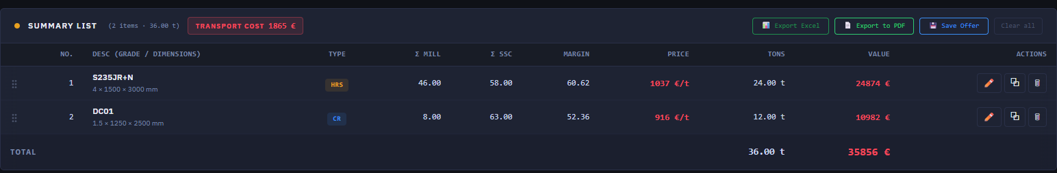
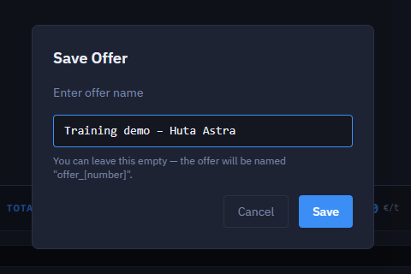
WALKTHROUGH · CALCULATOR · STEP 5
Build the list and save the offer
Each "Add to list" adds one product line. One offer can hold many lines.
1
2
3
5
4
1
Transport for the order
For all lines together.
4
Line actions
Edit, duplicate or delete a line.
2
Export
Excel, or a formatted PDF quote.
5
Reorder lines
Drag the handle to change the order on the quote.
3
Save offer
Name it, or leave empty for offer_[number].
AMSteel Quote · User Guide
11
Notes:
Summary list. The TOTAL row sums tonnes and value. Save stores the offer and moves you into edit mode for it; later changes are saved to the same offer. Saved offers appear in My Offers.

Slide 12
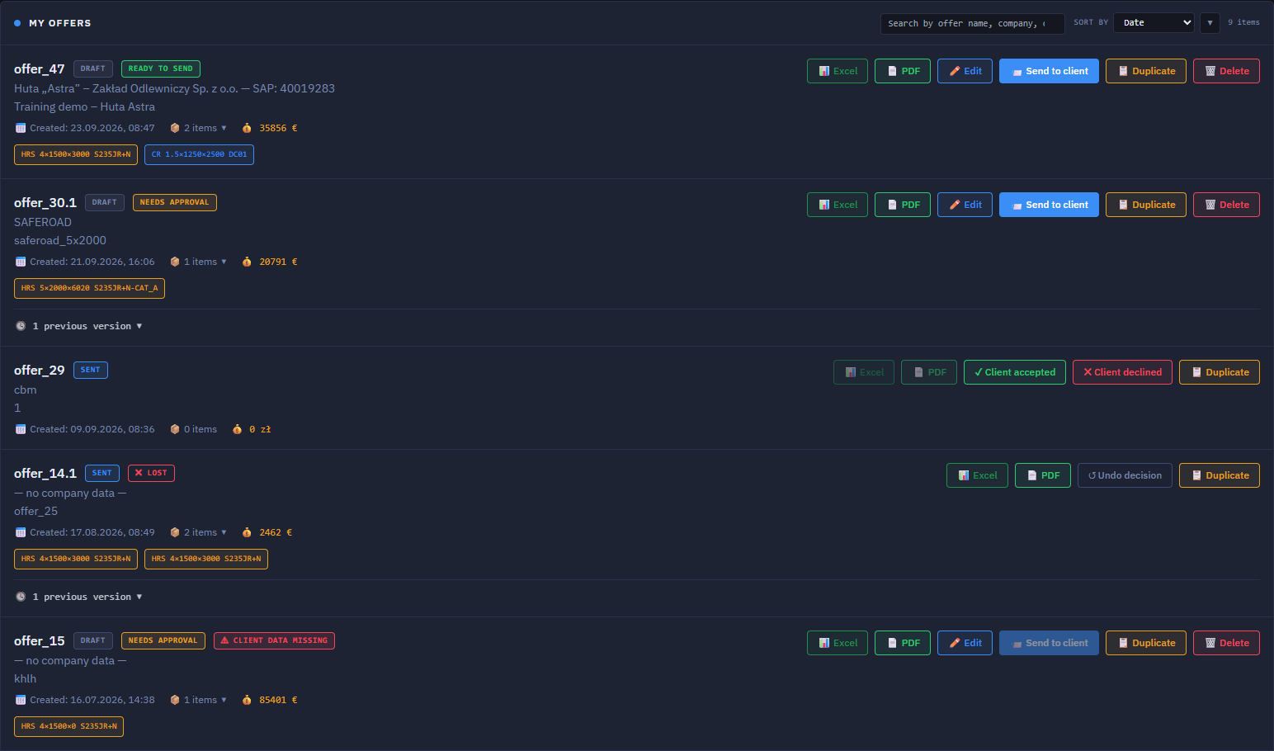
WALKTHROUGH · MY OFFERS
My Offers: everything you have quoted
Your own offers, newest first. Search, sort, and act on each one.
1
Status tags
Draft, Ready to send, Needs approval, Sent…
1
2
2
Actions
Excel, PDF, Edit, Send, Duplicate, Delete.
3
3
Versions
Expand to see earlier versions.
4
4
Client's answer
Once sent, record Client accepted or Client declined.
5
5
Undo decision
Recorded the wrong answer? Undo it.
6
6
What is blocking
Submit for review, or add company and Tax ID.
AMSteel Quote · User Guide
12
Notes:
My Offers lists only your own offers. The buttons change with the status: a sent offer is read-only (Excel, PDF, Duplicate), a draft can be edited or deleted. Juniors see Submit for review instead of Send to client when an offer breaks the pricing rules.

Slide 13
WALKTHROUGH · MY OFFERS
The life of an offer
Offers that break the pricing rules go through a review before they can reach the client.
Record answer
Within the rules
margin and base price OK
Draft
Send to client
Sent
Won · Lost
Submit for review
Approve
Send to client
Record answer
Needs approval
margin below minimum, or base price below the current PGL
Draft
Pending review
Approved
Sent
Won · Lost
Reject + comment
Seniors and admins can send their own offers directly.
Rejected
Company name and Tax ID must be filled in before sending.
Edit & resubmit
Sent offers are read-only. Use Duplicate to reuse one.
AMSteel Quote · User Guide
13
Notes:
Two paths. If every line meets the minimum margin and uses at least the current base price, the offer can be sent straight away. If any single line breaks a rule, the whole offer must be approved by a senior or admin first. This is enforced by the server, not just the screen. A rejected offer comes back with the reviewer's comment; edit it and submit again.

Slide 14
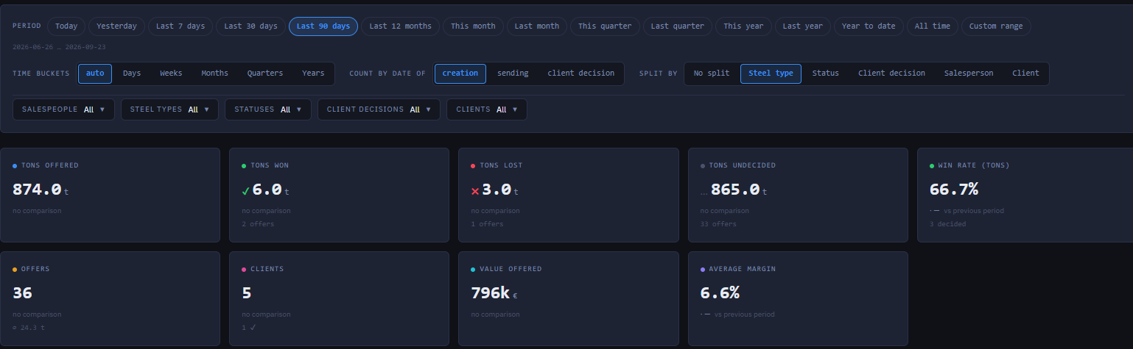
WALKTHROUGH · ANALYTICS
Analytics: filters and headline numbers
Everyone has Analytics. Juniors see their own offers, seniors add their team, admins see the company.
1
2
1
Period & time buckets
Quick ranges or a custom range; group by day, week, month, quarter or year.
3
2
Split by
Colour the charts by steel type, status, client decision, salesperson or client.
4
3
Filters
Narrow down by salespeople, steel types, statuses, decisions and clients.
Tons offered
All tonnes in offers in the period
Tons won / lost
Tonnes the client accepted / declined
Tons undecided
No answer from the client yet
4
Headline numbers
Key results for the selected period and filters.
Win rate (tons)
Won ÷ (won + lost)
Offers · Clients
How many offers, for how many clients
Value · Avg margin
Total € offered, and the average margin %
AMSteel Quote · User Guide
14
Notes:
Example: 6 t won and 3 t lost gives a win rate of 6 / 9 = 66.7%. Undecided tonnes do not count against the win rate. "Count by date of" decides whether an offer is placed in time by its creation, sending or client-decision date.

Slide 15
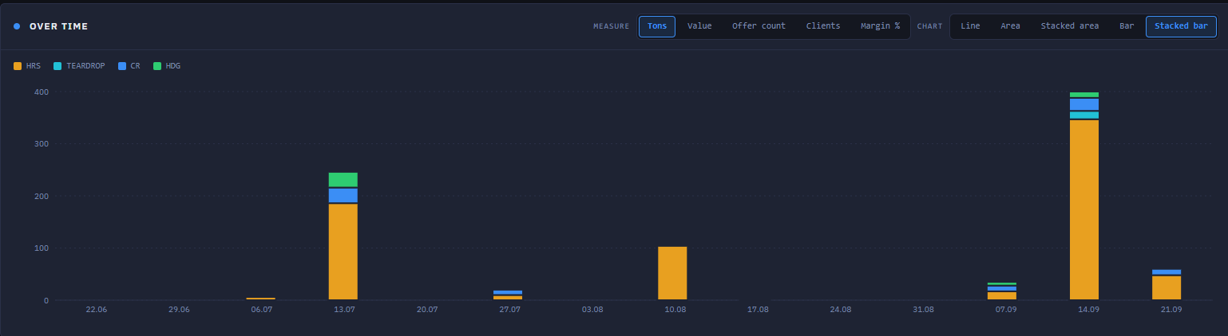
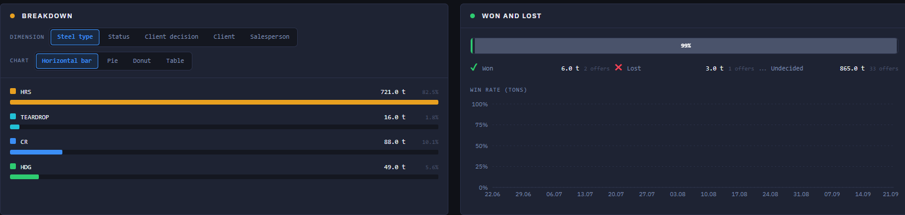
WALKTHROUGH · ANALYTICS
Analytics: charts
Every chart follows the filters above it. Switch what is measured and how it is drawn.
1
1
Measure & chart type
Tons, value, count, clients or margin; line or bar.
2
2
Legend
One colour per group from "Split by".
3
3
Over time
The measure across the period.
4
Breakdown
Dimension and chart: bar, pie, donut, table.
4
6
5
Shares
Each group's tonnes and share of the total.
5
6
Won and lost
Won, lost, undecided, and win rate over time.
AMSteel Quote · User Guide
15
Notes:
Charts. "Over time" and "Breakdown" use the same filters and split as the headline numbers, so all numbers on the page always agree.

Slide 16
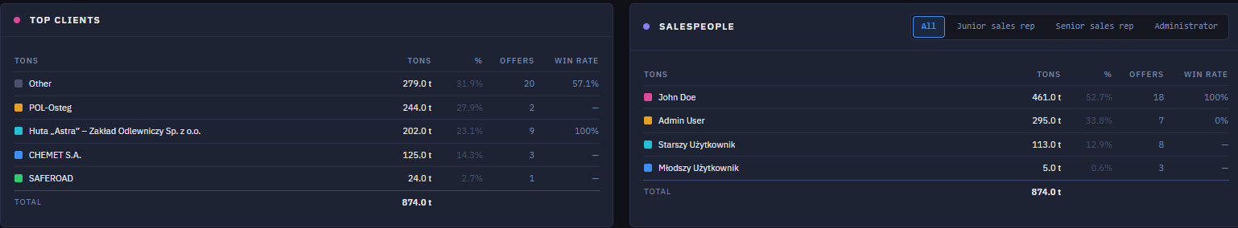
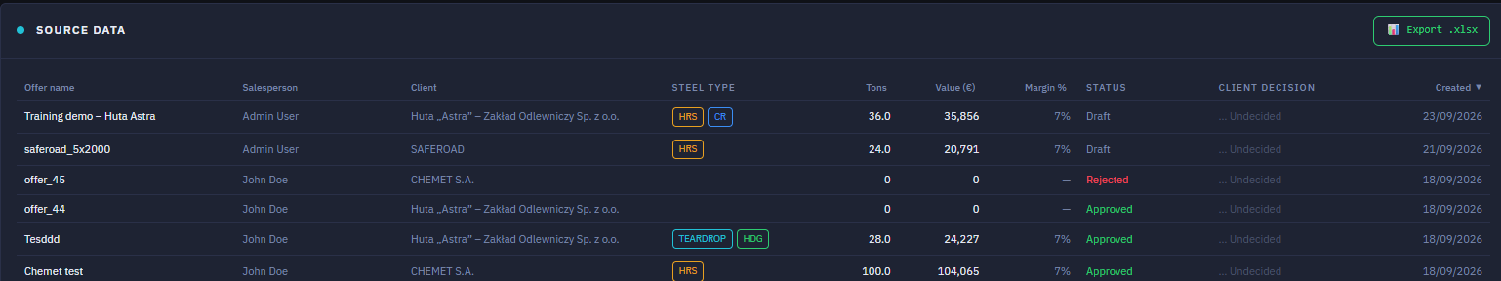
WALKTHROUGH · ANALYTICS
Analytics: rankings and source data
Who buys the most, who sells the most, and every offer behind the numbers.
2
1
Top clients
Tonnes, share, number of offers and win rate per client.
1
2
Salespeople
The same per person. Filter by role (visible for seniors and admins).
3
3
Export .xlsx
Download the source data as an Excel file.
4
4
Source data
Every offer counted above: salesperson, client, type, tons, value, margin, status, decision.
TIP Numbers look wrong? Check the period and the filters at the top first: every table here follows them.
AMSteel Quote · User Guide
16
Notes:
Rankings and source data. The source table is the audit trail for the charts: every number above can be traced back to the offers listed here.

Slide 17
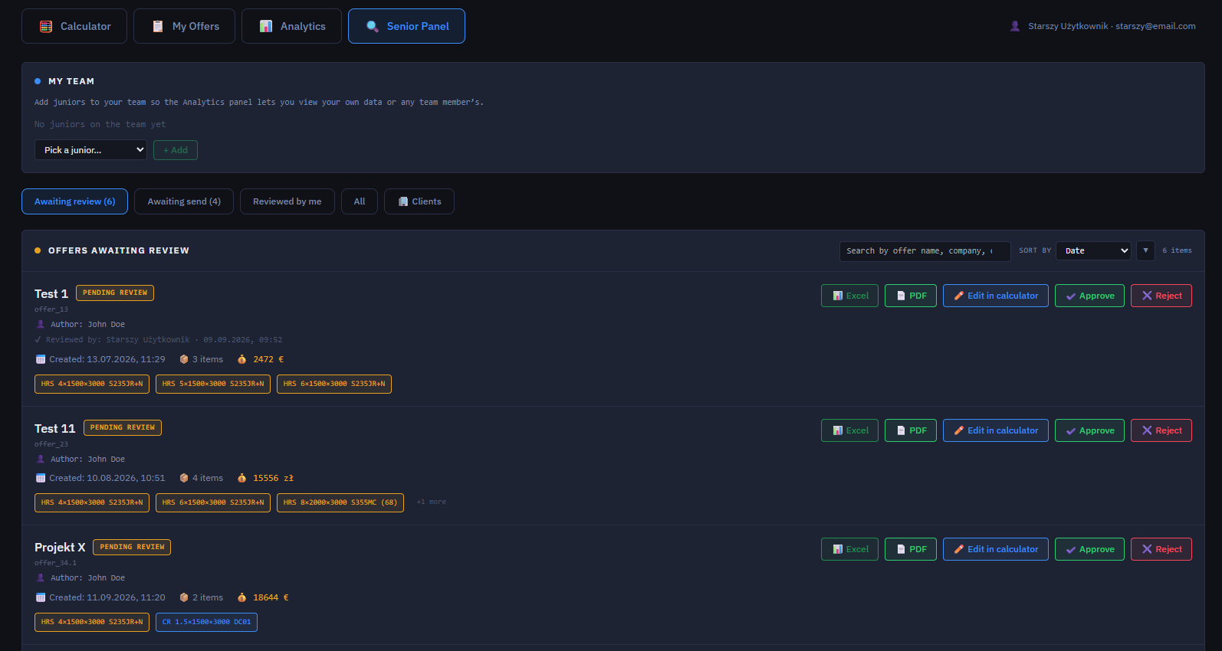
WALKTHROUGH · SENIOR PANEL
Senior Panel: the approval queue
Seniors only. Not a dashboard: this is where flagged offers from other people wait for you.
1
My team
Add juniors to your team so their numbers show up in your Analytics.
1
2
2
Queues
Awaiting review, Awaiting send, Reviewed by me, All, and Clients.
3
4
5
3
Who and what
Author, value and product lines of each offer; who reviewed it and when.
4
Edit in calculator
Fix the offer yourself before approving it.
5
Approve or Reject
Approve clears it for sending. Reject needs a comment (next slide).
AMSteel Quote · User Guide
17
Notes:
Senior Panel. Offers awaiting review are always listed first. Excel and PDF are available for every offer in the queue.

Slide 18
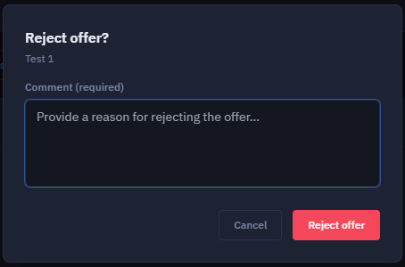
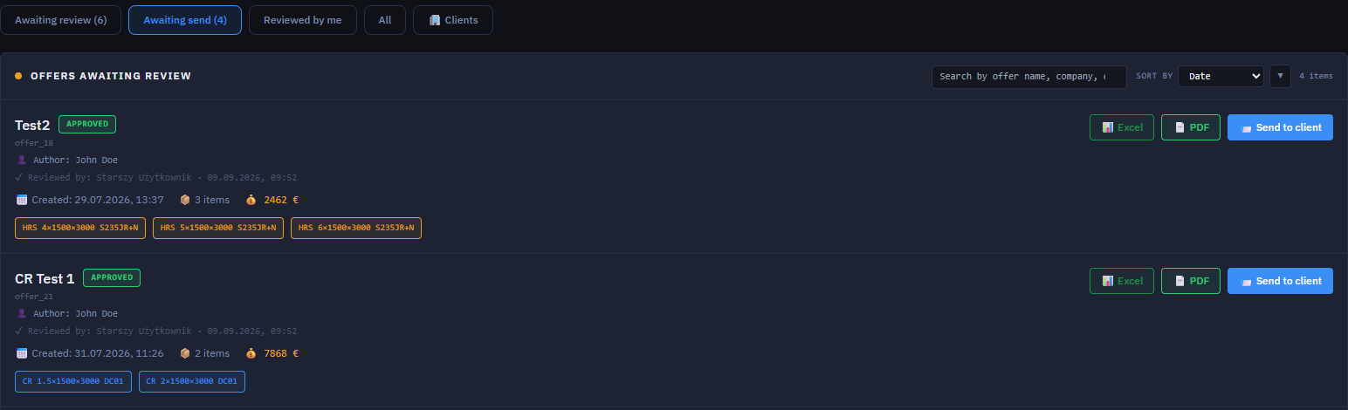
WALKTHROUGH · SENIOR PANEL
Reject with a reason, or send it on
A rejection always explains why. Approved offers wait in "Awaiting send".
3
4
5
1
3
Awaiting send
Approved offers that are not yet with the client.
2
4
Review trail
Who approved it, and when.
1
Write the reason
Required. The author sees it on the rejected offer.
5
Send to client
Marks the offer as sent. It becomes read-only.
2
Reject offer
The offer goes back to its author to fix and resubmit.
AMSteel Quote · User Guide
18
Notes:
Reject and send. A reject without a comment is not possible. Awaiting send lists offers that were approved but have not been sent yet; the senior or the author can send them.

Slide 19
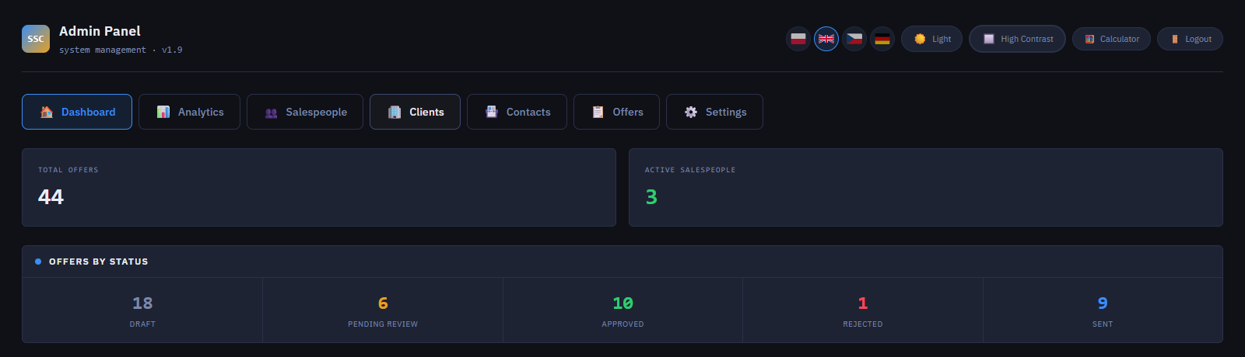
WALKTHROUGH · ADMIN PANEL
Admin Panel: the dashboard
Admins only. A quick company-wide summary, and the entry point to all admin pages.
1
Admin pages
Seven pages, shown below. Calculator is one click away (top right).
1
2
3
2
Total offers
Every offer in the company.
4
Active salespeople
Accounts that can currently log in.
3
4
Offers by status
Click a number to open those offers.
Dashboard
This summary
Analytics
Company-wide numbers
Salespeople
Accounts & performance
Clients
Client directory
Contacts
All contact people
Offers
Every offer
Settings
Prices & rules
AMSteel Quote · User Guide
19
Notes:
Admin dashboard. The status tiles are links: clicking "6 Pending review" opens Admin Panel → Offers filtered to pending review.

Slide 20
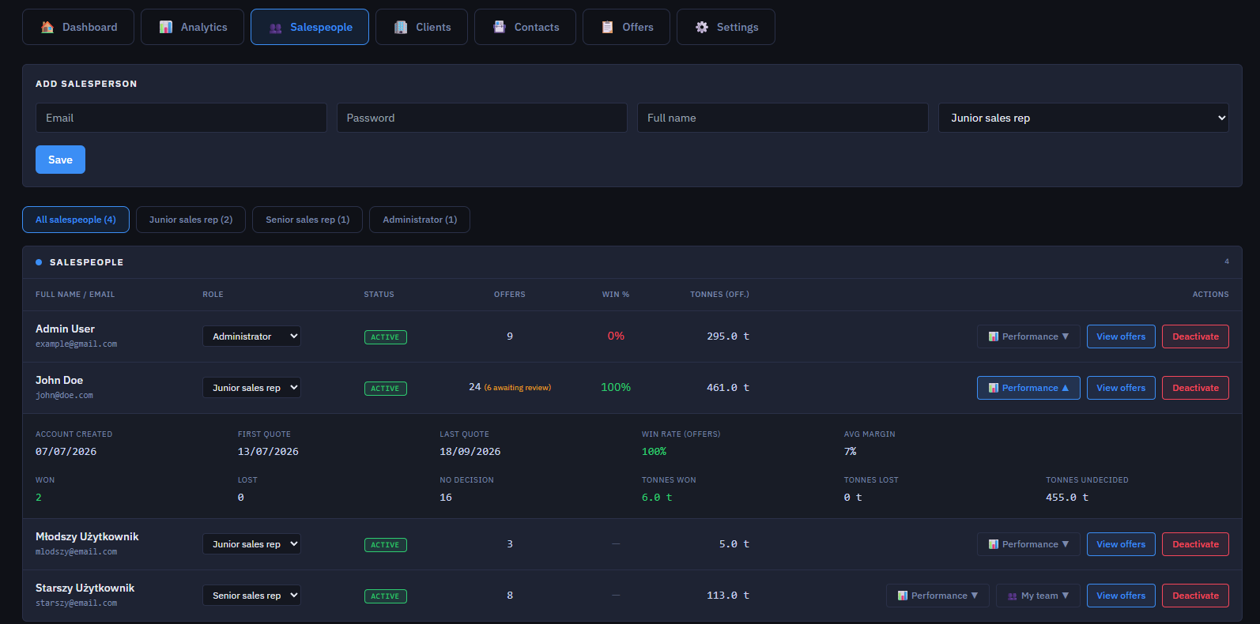
WALKTHROUGH · ADMIN PANEL
Salespeople: accounts and performance
Create accounts, change roles, switch access on or off, and see how each person is doing.
1
Add salesperson
Email, password, full name and role, then Save. This is the only way to create an account.
1
2
2
Filter by role
All, juniors, seniors or administrators.
3
Change role
Pick a new role from the dropdown.
3
4
5
4
Row actions
Performance, View offers, and Deactivate (blocks login).
5
Performance
First/last quote, won, lost, no decision, tonnes, win rate and average margin.
TIP Senior rows have a "My team" button: pick a junior and click + Add to put them on that senior's team.
AMSteel Quote · User Guide
20
Notes:
Salespeople. Deactivating is reversible and keeps all offers; the person just cannot log in. The number next to Offers in orange shows how many are awaiting review.

Slide 21
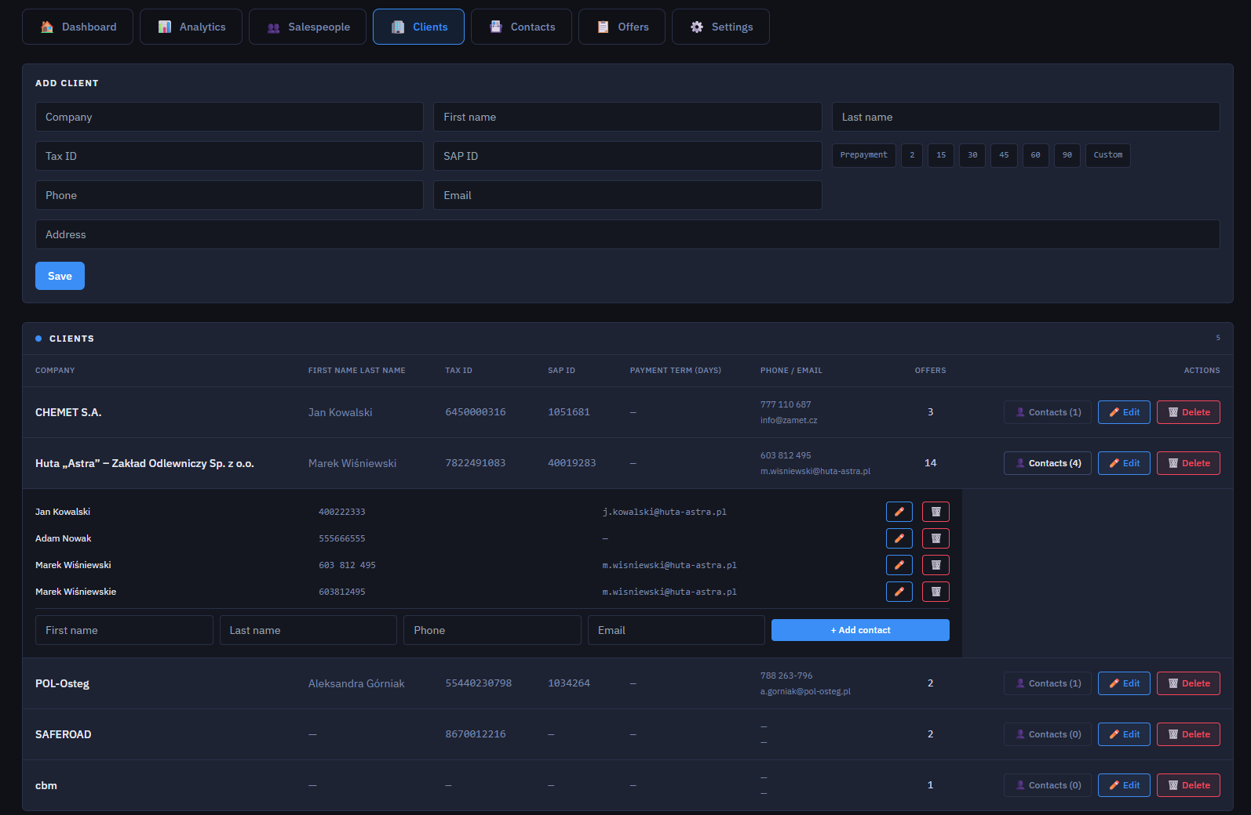
WALKTHROUGH · ADMIN PANEL
Clients: the client directory
Every company you quote for, with its details, contacts and number of offers.
1
Add client
Company, contact person, Tax ID, SAP ID, phone, email and address.
2
1
2
Client payment term
Optional. When set, the Calculator uses it instead of the default.
3
Contacts (n)
Expand a client to manage its people without leaving the page.
3
4
Edit contacts
Change or delete a person with the pencil and bin icons.
4
5
5
Add contact
Fill in the row and click + Add contact.
AMSteel Quote · User Guide
21
Notes:
Clients. The Offers column shows how many offers exist for each client. Clients are also created automatically when an offer is saved for a new company from the Calculator.

Slide 22
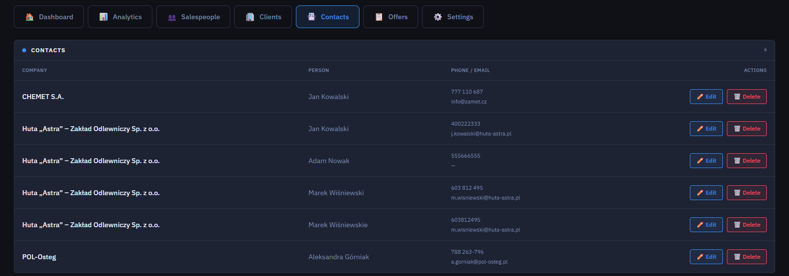
WALKTHROUGH · ADMIN PANEL
Contacts: every contact person in one list
A flat list across all clients, mainly for cleaning up or correcting details.
1
All contacts
Company, person, phone and email for everyone saved.
1
2
2
Edit or delete
Fix a typo, update a phone number, remove duplicates.
TIP New contacts are normally added from the Calculator while building a quote ("Save contact to company") or under Clients → Contacts.
AMSteel Quote · User Guide
22
Notes:
Contacts. Duplicates (for example the same person saved twice with different spelling) are easy to spot here and can be deleted.

Slide 23
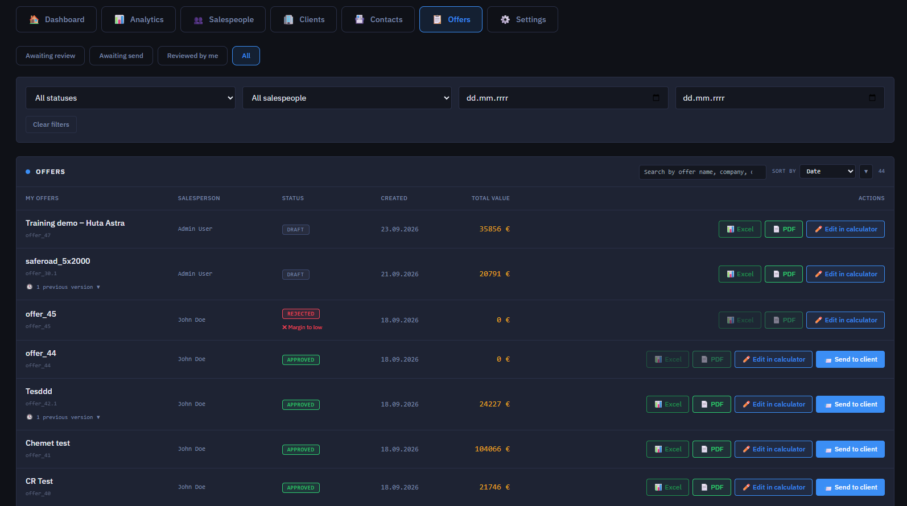
WALKTHROUGH · ADMIN PANEL
Offers: every offer in the company
Company-wide, no matter who created it. Filter, review, open and export.
1
Quick views
Awaiting review, Awaiting send, Reviewed by me, All.
1
2
2
Filters
Status, salesperson, date range.
3
3
Search & sort
By offer name, company and more.
4
4
Open any offer
Edit in calculator shows every line and its price breakdown.
5
6
5
Rejection reason
Rejected offers show why, right under the status.
6
Next action
Send (approved) or Approve / Reject (pending).
AMSteel Quote · User Guide
23
Notes:
Admin offers. Admins can open and edit any offer in any status. This is also where admins approve or reject offers, because the Senior Panel tab is for seniors.

Slide 24
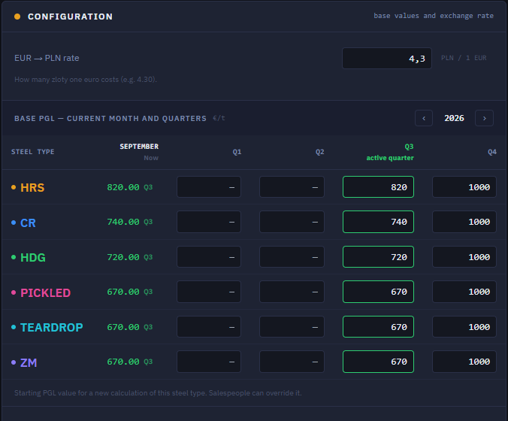
WALKTHROUGH · ADMIN PANEL · SETTINGS
Settings: exchange rate and base prices
The pricing control panel. Every default number the Calculator uses starts here.
1
EUR → PLN rate
Everything is priced in euro; PLN is only a converted display value.
1
2
Year
Browse the quarters of other years.
2
3
Price in effect now
The base PGL per steel type for the current month, and where it comes from.
4
Active quarter
Edit this quarter's value to change today's price.
5
Future quarters
Enter a price in advance: it takes effect automatically when the quarter starts.
3
4
5
NOTE Changes apply to new calculations only. Saved, pending and sent offers keep the prices from the day they were priced.
AMSteel Quote · User Guide
24
Notes:
Base PGL. The Calculator starts each line from the base price for its steel type; a salesperson can override it on a single line, but going below the current base price sends the offer for approval.

Slide 25
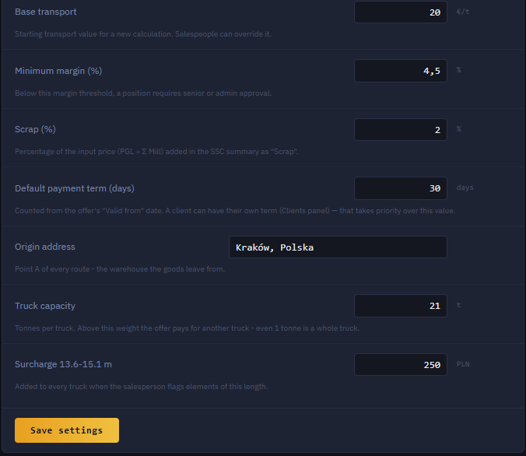
WALKTHROUGH · ADMIN PANEL · SETTINGS
Settings: pricing rules and defaults
The rules behind margins, scrap, payment terms and trucks. Click Save settings when done.
1
1
Base transport
Starting transport €/t before a route is calculated.
2
Minimum margin
Below this %, an offer needs senior or admin approval.
2
3
3
Scrap %
Share of the input price added as scrap for cut sheets.
4
4
Default payment term
Used when the client has no term of its own.
5
5
Origin address
Where every route starts: the warehouse.
6
6
Truck capacity
Tonnes per truck. One tonne over means one more truck.
7
7
Long-element surcharge
PLN added per truck for 13.6–15.1 m elements.
AMSteel Quote · User Guide
25
Notes:
Pricing rules. The minimum margin is the approval trigger: it is checked on the server when an offer is sent, so it cannot be bypassed.

Slide 26
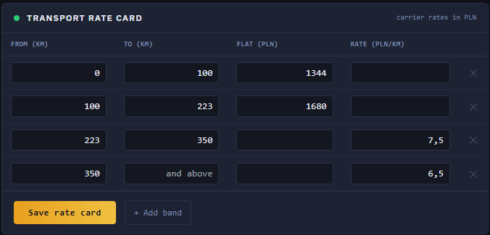
WALKTHROUGH · ADMIN PANEL · SETTINGS
Settings: transport rate card
What one truck costs, by distance band. Carrier rates are in PLN.
1
Flat-price bands
Short routes: one fixed price per truck for the whole band.
1
2
Per-kilometre bands
Longer routes: price per km × distance. Leave the last band open-ended.
2
3
Edit & save
Add a band, change values, then Save rate card.
3
EXAMPLE Kraków → Gdańsk is 616.7 km, so the open "350 km and above" band applies: 616.73 km × 6.5 PLN = 4,008.75 PLN per truck.
RULE A band has either a flat price or a per-km rate, never both.
AMSteel Quote · User Guide
26
Notes:
Rate card. The route distance picks the band; the band gives the price of one truck. The Calculator then multiplies by the number of trucks and converts to € per tonne.

Slide 27
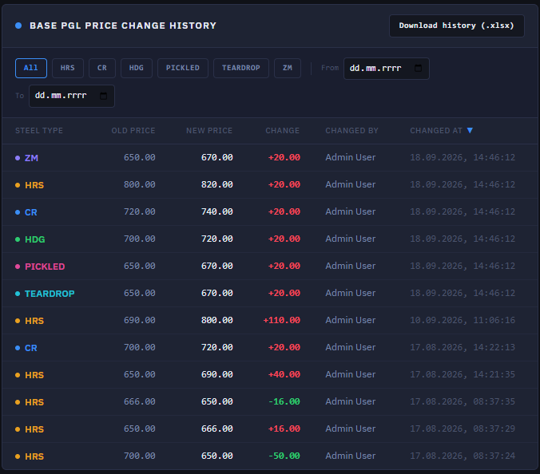
WALKTHROUGH · ADMIN PANEL · SETTINGS
Settings: base price change history
Every base price change is logged automatically: who changed what, and when.
2
1
Filter
By steel type and by a date range.
1
2
Download history
Export the log as an Excel file (.xlsx).
3
The log
Old price, new price, the change, who made it and the exact time.
3
WHY IT MATTERS Accountability built in: nobody has to remember to write a price change down. The app records it every time.
AMSteel Quote · User Guide
27
Notes:
Price history. A strong point for audits: every change to a base price is traceable to a person and a timestamp. User accounts are managed under Salespeople, not in Settings.

Slide 28
03
Pricing logic
How the Calculator arrives at a price:
the five steps, delivery, currency, rounding and the safety net.

Slide 29
03 · PRICING LOGIC
How a price is built: five steps, always in this order
No shortcuts or exceptions. Every line on every offer goes through the same sum.
1
2
3
4
5
Base price
Mill surcharges
Processing
Margin, extra, delivery
Final price
Price per tonne for the steel type (PGL), set by the admin in Settings per quarter.
+
Thickness & width, grade, tolerance, certificate, and type-specific extras such as coating.
+
Only for cut sheets, not coils: dimension charge, small add-ons (flatness, marking, packing) and scrap as a % of the input price.
+
Your margin % of the input price, any manual extra €/t, and delivery for the whole order in €/t.
+
Everything added up and rounded up, per tonne. × tonnes = line value. Lines add up to the offer.
= input price
= €/t, rounded up
WORKED EXAMPLE · values from the Calculator screenshot (HRS sheet 4 × 1500 × 3000 mm)
820 base + 46 mill = 866 input + 58 processing + 60.62 margin (7% of 866) + 0 extra + 20 transport = 1,004.62 → 1,005 €/t
Processing 58 = base surcharge 31 + surface 10 + scrap 17 (2% of 866 = 17.32, shown rounded). The total is rounded up, never down.
AMSteel Quote · User Guide
29
Notes:
The five steps. Step 3 is skipped for coils. The final number is always rounded up: the company would rather round slightly in its own favour than accidentally undercharge. Check of the example: 866 + 58 + 60.62 + 0 + 20 = 1,004.62, rounded up to 1,005 €/t.

Slide 30
03 · PRICING LOGIC
How delivery is priced
Worked out once for the whole order, then folded into the price per tonne.
1
Find the distance
The delivery address is looked up automatically with an online mapping service. If it fails, type the km by hand.
WORKED EXAMPLE
Distance, Kraków → Gdańsk | 616.73 km
Rate card band: 350 km and above | 6.5 PLN / km
Price per truck | 4,008.75 PLN
24 t ÷ 21 t per truck = 1.14, rounded up | 2 trucks
Transport cost | 8,017.50 PLN
In euro (÷ 4.3 PLN / €) | 1,864.53 €
Per tonne (÷ 24 t) | 77.69 €/t
2
Count the trucks
Total tonnes ÷ truck capacity, always rounded up. Half a tonne over a full truck pays for another truck.
3
Price each truck
From the rate card: a flat price for short distances, a price per km for long ones, plus a surcharge for long elements.
4
Convert to €/t
Truck cost × trucks, converted from PLN to €, divided by the tonnes, and added to the final price.
Values from the Calculator screenshots. Rates and capacity are set in Settings and change over time.
AMSteel Quote · User Guide
30
Notes:
Delivery. Check: 616.73 × 6.5 = 4,008.75 PLN; × 2 trucks = 8,017.50 PLN; ÷ 4.3 = 1,864.53 €; ÷ 24 t = 77.69 €/t, which is the Transport value shown in the Calculator.

Slide 31
03 · PRICING LOGIC
Currency, rounding and the safety net
Three rules that protect the company from pricing mistakes.
1
Euro inside
2
Always round up
3
The safety net
Everything is calculated in euro. Polish zloty is only a converted display value, using the exchange rate in Settings.
Prices round up, never down. A deliberate choice: better slightly in the company's favour than accidentally undercharging.
If any line's margin is below the minimum in Settings, or its base price is below the current PGL, the whole offer is flagged and cannot be sent until a senior or admin approves it.
IMPORTANT The safety net is enforced on the server, not only on screen. It is not a warning you can click past: the app refuses to send the offer.
AMSteel Quote · User Guide
31
Notes:
One weak line is enough to flag the whole offer, because all lines go to the client in the same document. The check uses the current Settings, so if the admin raises a base price later, unsent offers are re-checked against the new value.

Slide 32
04
Tech & hosting
What the app is built with,
and where it can run.

Slide 33
04 · TECH & HOSTING
The technology, in plain words
Mainstream, well-tested tools. Nothing experimental.
Piece | Technology | In plain terms
Programming language | TypeScript | A stricter, safer JavaScript that catches mistakes before the app runs.
Web framework | Next.js 14 | Turns the code into a working website and handles moving between pages.
User interface | React 18 | Builds the buttons, forms and screens. The most widely used tool of its kind.
Look and layout | HTML, CSS, Tailwind, Radix UI | Page structure and styling, plus ready-made accessible dropdowns and dialogs.
Animations · Forms · Charts | Framer Motion · React Hook Form + Zod · Recharts | Smooth transitions, input checking, and the charts in Analytics.
Database | PostgreSQL | Stores everything: clients, offers, prices, users. Mostly hand-written SQL.
Login and accounts | Custom login system | Secure cookie; your permission level is checked on every action, not only at login.
PDF quotes | Abacus.ai service | Turns a finished quote into a formatted PDF.
Delivery distance | Geoapify, fallback Nominatim + OSRM | Converts an address into kilometres automatically.
AMSteel Quote · User Guide
33
Notes:
The stack. Everything lives in one PostgreSQL database; there is nothing scattered across other systems. The live price preview runs entirely in the browser, which is why it feels instant; only saving and looking up a new delivery distance need the network.

Slide 34
04 · TECH & HOSTING
Where the app can run
It needs two things: a place to run the website code, and a PostgreSQL database.
1
A local server
2
AWS (Amazon)
3
Azure (Microsoft)
A normal computer or company server you own and control.
Amazon's cloud, with its managed PostgreSQL service.
Microsoft's cloud, same idea as AWS.
GOOD FOR
GOOD FOR
GOOD FOR
Cheapest. Good for demos or a small team.
Companies already on Amazon, or wanting its reliability and support.
Companies already using Microsoft tools like Office 365.
NO LOCK-IN None of these needs a change to the app itself. Moving between them is a hosting decision, not a rebuild. The app was checked for cloud-specific code and has no lock-in to any provider.
Today the app runs on Abacus.ai. That is simply where it lives at the moment, not a requirement.
AMSteel Quote · User Guide
34
Notes:
Hosting. Any developer or IT provider familiar with Next.js and PostgreSQL can set it up. During development it runs on a local machine with a local copy of the database.

Slide 35
QUICK REFERENCE
I want to… where do I go?
Keep this page handy.
I want to… | Go to
Price a new offer | Calculator
Find, edit, export or duplicate my offer | My Offers
Get a flagged offer approved | My Offers → Submit for review
Record the client's answer | My Offers → Client accepted / declined
See my (or my team's) results | Analytics
Approve or reject someone's offer | Senior Panel (seniors) · Admin Panel → Offers (admins)
Create an account or change a role | Admin Panel → Salespeople
Add or fix a client or contact | Admin Panel → Clients / Contacts
Change a base price, rate or rule | Admin Panel → Settings
AMSteel Quote · User Guide
35
Notes:
Quick reference for everyday tasks.

Slide 36
You are ready to quote.
Questions about access or prices? Contact your administrator.
Questions about an offer? Ask your senior sales rep.
AMSteel Quote · User Guide · v1.9
Notes:
End of the guide.

